Slide 1
Presentation on computer graphic
Made by – Achal Gupta

Slide 2
Computer Graphic
Computer + graphic
It is an art of drawing picture ,lines, charts etc. using computer with the help of program and software.

Slide 3
History
In 1963, Ivan Sutherland, developed a Sketchpad in which images can be drawn on the screen using a light pen.
Later he developed virtual reality equipment and designing flight simulator system.

Slide 4
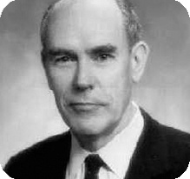

Slide 5
Things come under computer graphic
Representation
Manuplation
stroage

Slide 6
Application of computer graphic
Cartography
Computer added drafting and design
User interfaces
Office automation and desktop publishing:-
Simulation and animation

Slide 7
Type of
computer graphic
Interactive graphic
Non-interactive graphic

Slide 8
Type of image in
computer graphic
Vector image
Raster image

Slide 9
Thank you

